Slide 1

Software Design and architecture (SE322) gg
Week 02
Said Nabi
said.nabi@giki.edu.pk
Faculty of Computer Science and engineering
Gik Institute Topi, Swabi

Slide 2
List of Topics
Technical Design
Compromise
Design for Quality Attributes
Context and Consequences
Satisfying FRs and NFRs
CRC Cards
Creating OO Models
OO modeling Principles (Abstraction, Encapsulation, Generalization, Decomposition)

Slide 3
Technical Design:
Technical designs build on conceptual designs and requirements to define the technical details of the solution.
In CD the software’s main components, connections, and responsibilities are outlined.
Technical Design brings this information to the next stage—it aims to describe how these responsibilities are met.
It is not finished until each component has been refined to be specific enough to be designed in detail.
To achieve this, technical designs break components into smaller parts detailed enough for design.”

Slide 4
Technical Design Cont…
In technical design, we keep breaking down big components into smaller parts, each with clear responsibilities, until they can be designed in detail.
To communicate these designs, we use technical diagrams, since conceptual mock-ups are often not precise enough.
These diagrams show the structure and behavior of each component and help coordinate development work.

Slide 5

Compromise
When designing software, it is important to consider multiple perspectives.
Must satisfy qualities that matter to users as well as developers.
The way software is structured impacts performance quality (for users) and reusability & maintainability (for developers).
Performance vs. Maintainability
Performance vs. Security

Slide 6
Compromise cont…
Designing solutions often requires compromises between client desires and technical constraints
Designs must be revised if the conceptual components or connections can’t be realized technically or don’t meet requirements.
It is easier to re-design in the planning stages, than once coding has started.
Larger systems demand more detailed design and component breakdowns, ensuring feasible plans that guide development effectively.

Slide 7
Design for Quilty Attributes
Sometimes, there are restrictions on design that require compromise.
Besides functional requirements, quality attributes define how well the software performs.
Decisions often involve balancing trade-offs between attributes like performance, convenience, and security.
Quality attributes can conflict in different situations, so architects must balance them against product requirements to find the best compromise.
This ongoing process often involves prioritizing attributes and considering deadlines that limit what’s feasible.

Slide 8

Example
Designing a front door to a house. Security is a quality attribute that might be important,
but if you add too many locks to the door, it may be difficult to open easily and will become inconvenient to use.
A good design should balance security with convenience and performance

Slide 9
Context and Consequences
Context provides important information when deciding on the balance of qualities in design.
Software For Public
Software for Corporate
Sometimes, choices made in software design have unintended consequences.
Suitable for small data, not large data
Prototype alternatives and test for best results

Slide 10
Satisfying Qualities FRs
Qualities stem from fulfilling both functional and non-functional requirements, which guide the entire design process.
Functional requirements define the expected behavior or tasks of a system or application—what it should do.
Correctness is a key quality achieved by meeting functional requirements, ensuring the system performs as intended.
In a music app, a functional requirement could be the ability to download and play songs.
The design must propose a solution that accurately fulfills this requirement, ensuring functionality is delivered as expected.

Slide 11
Satisfying Qualities NFRs
Non-functional requirements define how well a system performs its functions, focusing on quality attributes rather than specific behaviors.
NF requirements include performance, efficiency, and resource usage, which are typically measurable during software execution.
In a music app, a non-functional requirement might limit music downloads to a specific memory size, ensuring efficient resource use.
Other key non-functional qualities include reusability, flexibility, and maintainability, which support long-term software adaptability.
These qualities influence how easily the software can be modified, extended, or maintained in response to future needs.
Notes:
focusing on quality attributes rather than specific behaviors.

Slide 12
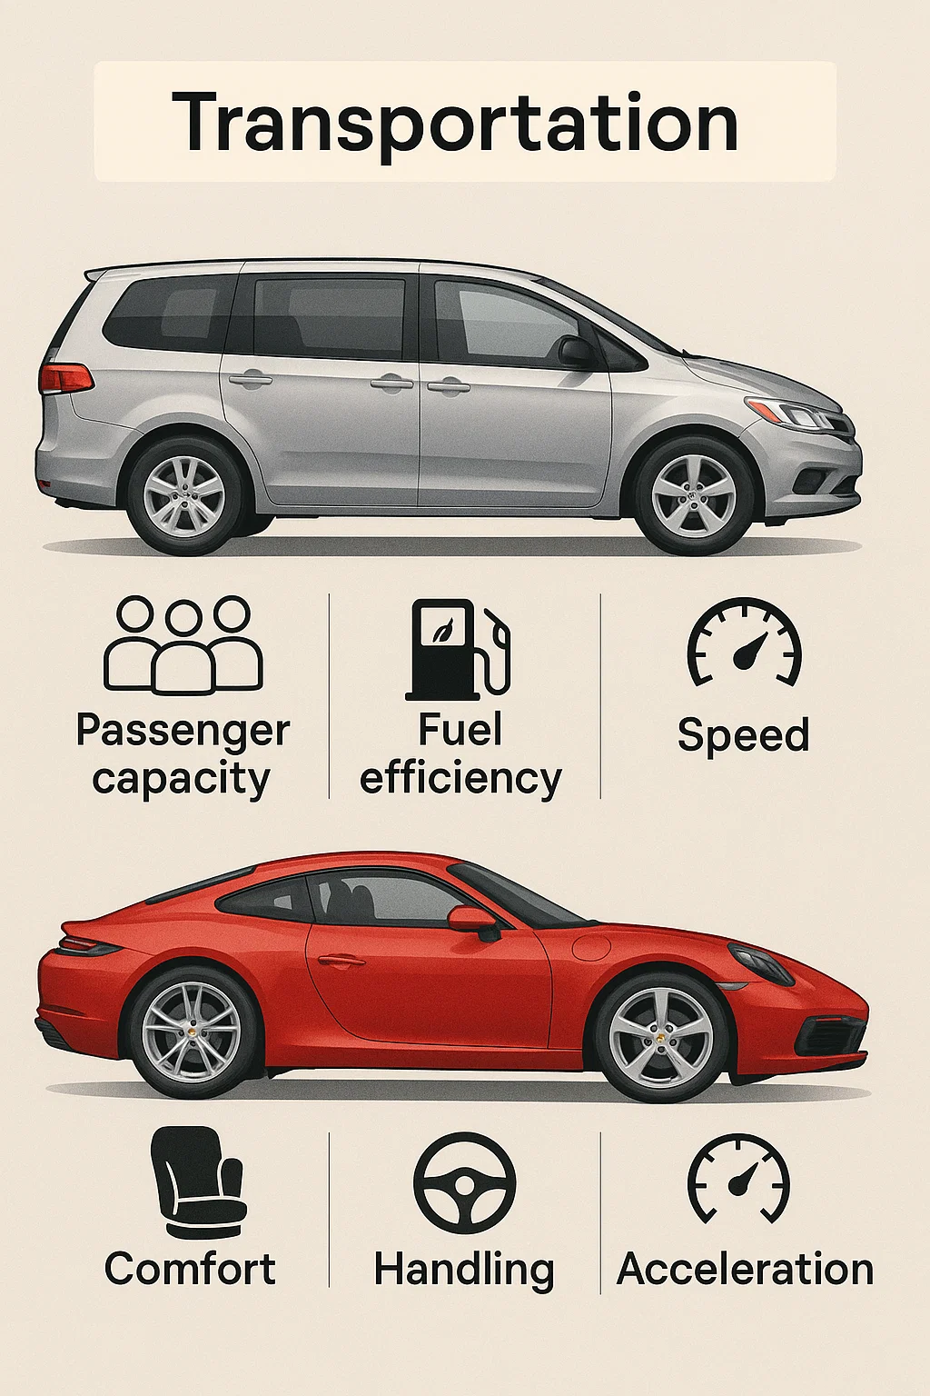
Satisfying Qualities
Satisfying functional and non-functional requirements is crucial, but real-world constraints often require trade-offs.
Open communication with stakeholders is essential to understand which compromises are acceptable.
All cars fulfill the basic functional requirement of transportation, but differences in non-functional qualities like speed, handling, and fuel efficiency distinguish a minivan from a sports car.

Slide 13
CRC Cards
CRC Cards (Class, Responsibility, Collaborator) are used in conceptual design.
They help:
Record and organize components into classes.
Identify component responsibilities.
Show how components collaborate.
Useful for refining software design components.
Structure of a CRC card:
Top → Class name
Left → Responsibilities
Right → Collaborators
Typically the size of a physical index card.
Class Name
Responsibilities
Collaborators

Slide 14
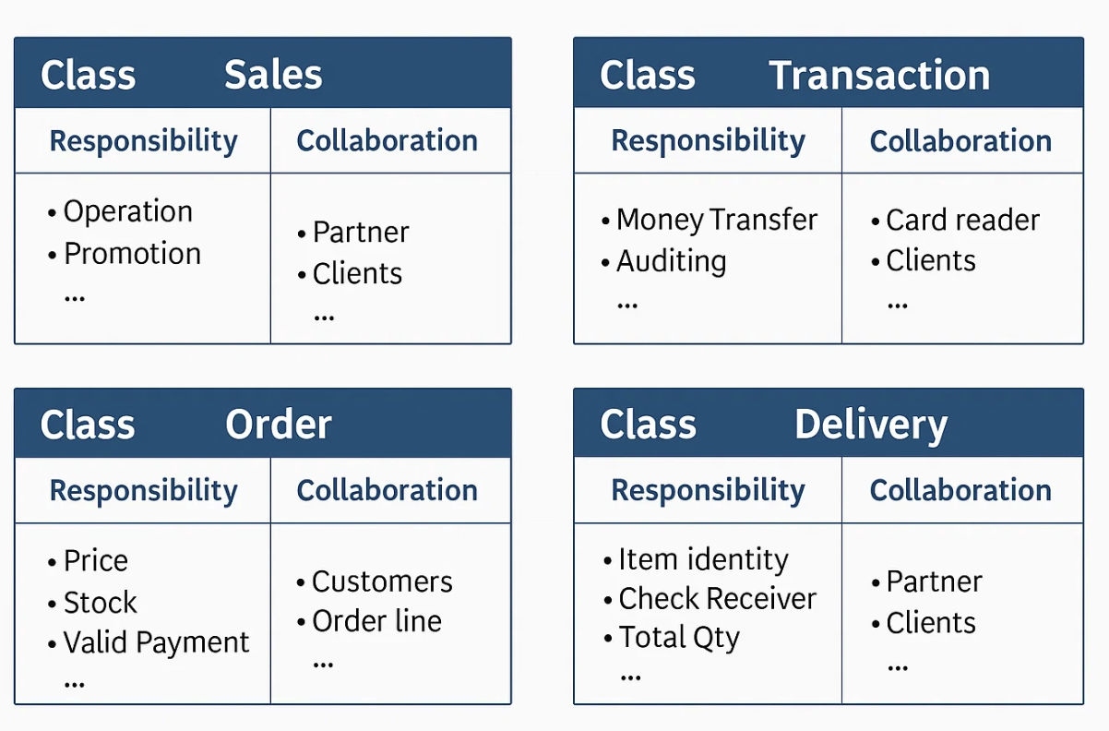
CRC Cards Example

Slide 15
Advantages of CRC Cards
CRC cards are simple, cheap, and editable tools to organize design into manageable pieces.
They let you reorganize components physically, explore relationships, and identify design flaws.
By moving cards around, you can experiment with alternative designs and prototype system behavior.
Cards should be grouped by closely collaborating components to clarify connections.
Useful in team meetings for visual explanation, discussion, and feedback.
Most powerful for prototyping and simulation in conceptual design, though other techniques also exist.
Class Name
Responsibilities

Slide 16
Creating OO Models
Don’t jump straight to coding → first understand requirements & design
Design sits between requirements & implementation
Iterative: deals with both problem space & solution space
Must be understandable to both users & developers
Object-Oriented Approach
Describes concepts as objects understood by users & developers
Helps solve complex problems with shared knowledge
C
lass Name

Slide 17
Object Categories in Models
Entity Objects → Focus in problem space
Control Objects → Handle events & coordinate actions
Boundary Objects → Connect system with external World
Role of Software Models
Help organize design & simplify complex problems
Ensure reusability, flexibility, maintainability
Serve as design documentation & may map to skeletal code
Unified Modeling Language (UML)
Provides visual notation for software models
Different diagrams focus on different issues
Structural model shows what objects do & how they relate

Slide 18
Creating OO Models Cont….
Four major design principles: Abstraction, Encapsulation, Decomposition, Generalization
Help in problem solving and building flexible, reusable, maintainable software
Key principles for developing good software design
Expressed in Java code and UML class diagrams (abstraction, encapsulation, decomposition)
Generalization explored through inheritance & interface
Class Name
Responsibilities
Collaborators

Slide 19
Design’s Principles in OOM
Object-oriented models systems using objects, guided by four key design principles:
Abstraction
Encapsulation
Decomposition
Generalization
Class Name
Responsibilities
Collaborators

Slide 20
Abstraction
One of the main ways that humans deal with complexity. It is the idea of simplifying a concept in the problem domain.
Abstraction simplifies a concept by ignoring unimportant details and focusing on essentials.
Should follow the rule of least astonishment
—capture only essential attributes/behaviors, avoid surprises or irrelevant details.
Class Name
Responsibilities
Collaborators

Slide 21
Abstraction Cont…
Abstraction depends on context, since what is essential changes with perspective
— a ‘person’ in a game app differs from a ‘person’ in a fitness app.
An abstraction captures both basic attributes (like age) and basic behaviors (like eating or sleeping).
Only relevant details should be included, as context defines what matters and what can be ignored.
This keeps class designs simple, focused, and easier to understand, but abstractions must be revisited if the system’s purpose changes.
Class Name
Responsibilities
Collaborators

Slide 22
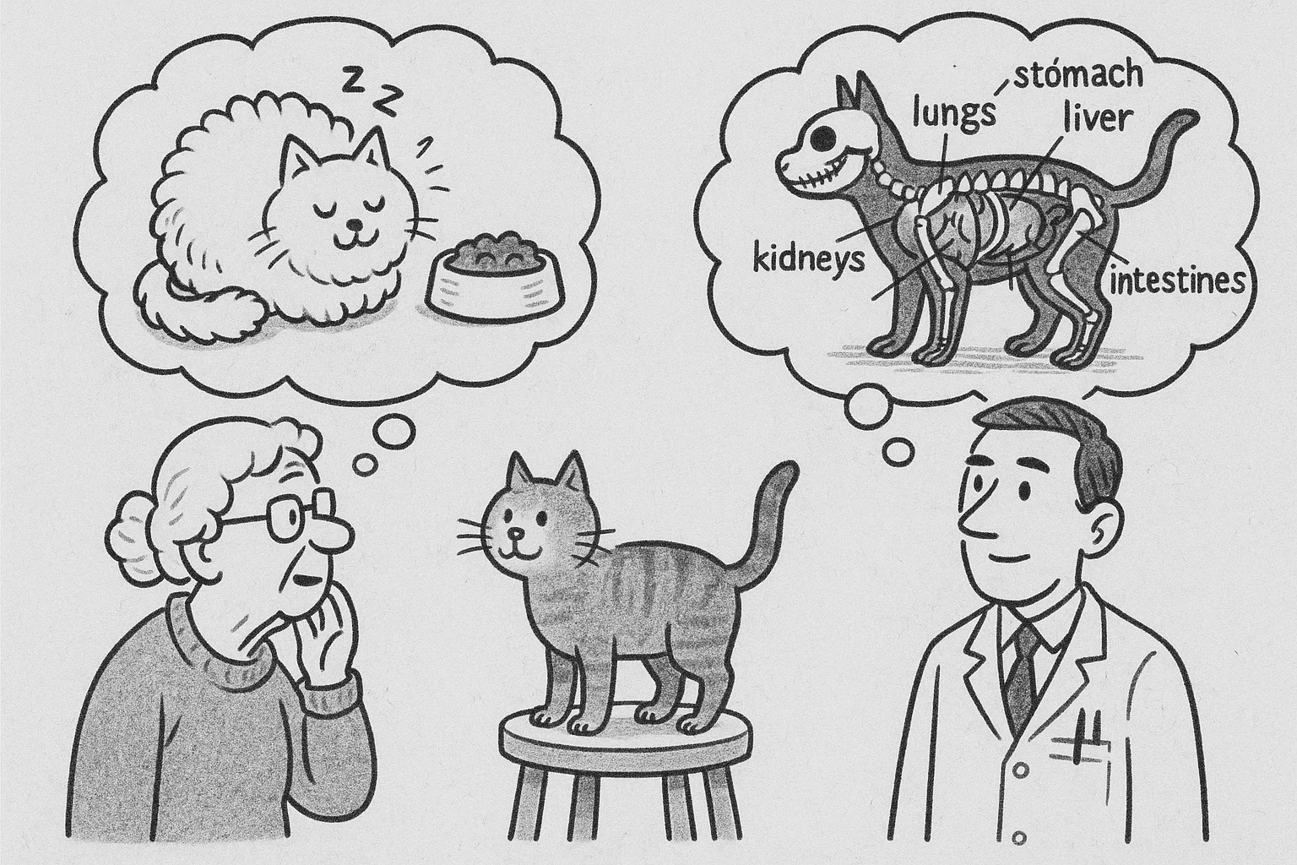
Class Name
Responsibilities
Collaborators

Slide 23
Encapsulation
Encapsulation means containing data and behaviors in a single unit,
like a capsule,
some parts are accessible
others are hidden.
It bundles attributes and functions into a class, exposes only
selected parts through interfaces,
restricts access to sensitive details.
Ensures each object has its own data and behaviors,
making programming easier
keeping data and related code together.
It builds on abstraction by not just identifying essentials but also packaging them in one place.
Class Name
Collaborators

Slide 24
Encapsulation Cont…
By restricting direct access, it protects
data integrity and sensitive information
while allowing controlled changes.
With black box thinking, classes hide their internal workings
only provide inputs and outputs through methods
reducing complexity.
This makes software more modular, reusable, secure, and easier to maintain or modify without affecting other parts of the system.

Slide 25
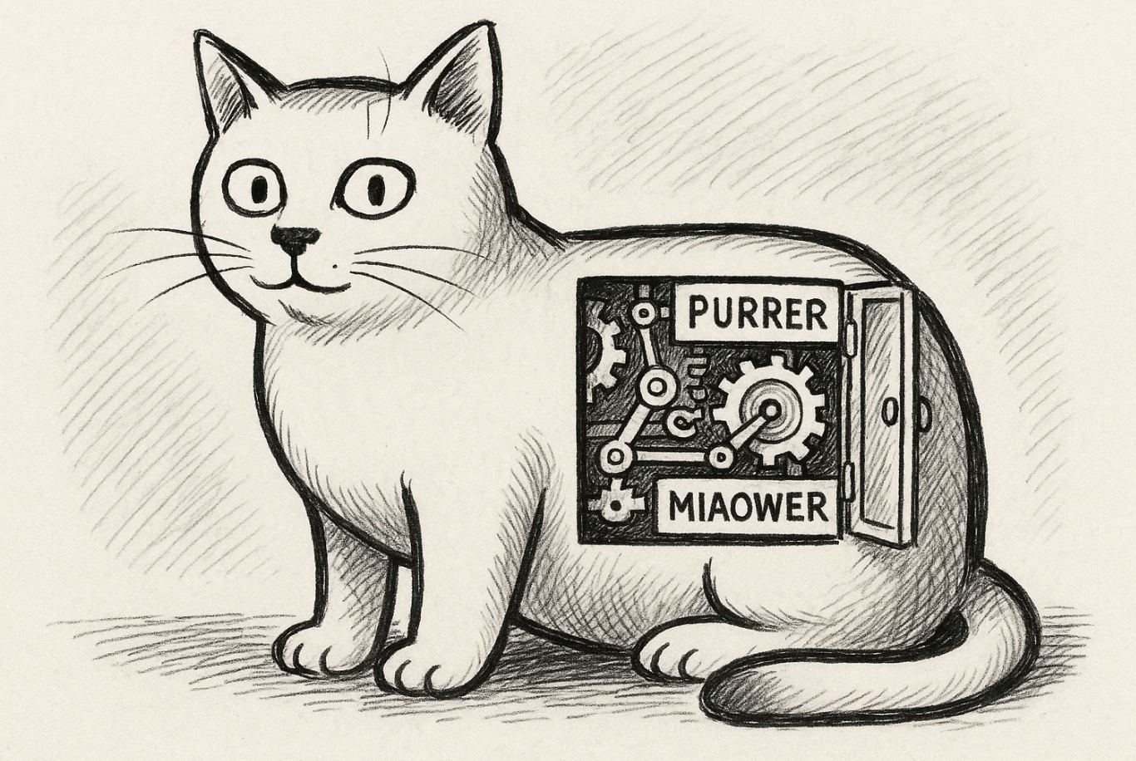
Class Name
Collaborators

Slide 26
Decomposition
the principle of breaking a whole into smaller parts, or combining parts to form a whole
making problems easier to understand and solve.
Each part becomes an object with a specific responsibility, often represented by its own class, while the whole relates to its constituent parts.
Parts can be fixed or dynamic and they may share or differ in lifetimes with the whole.
oven with 4 burners
food items in a fridge
Decomposition helps organize, encapsulate, and model complex systems by clarifying relationships between wholes and parts.

Slide 27
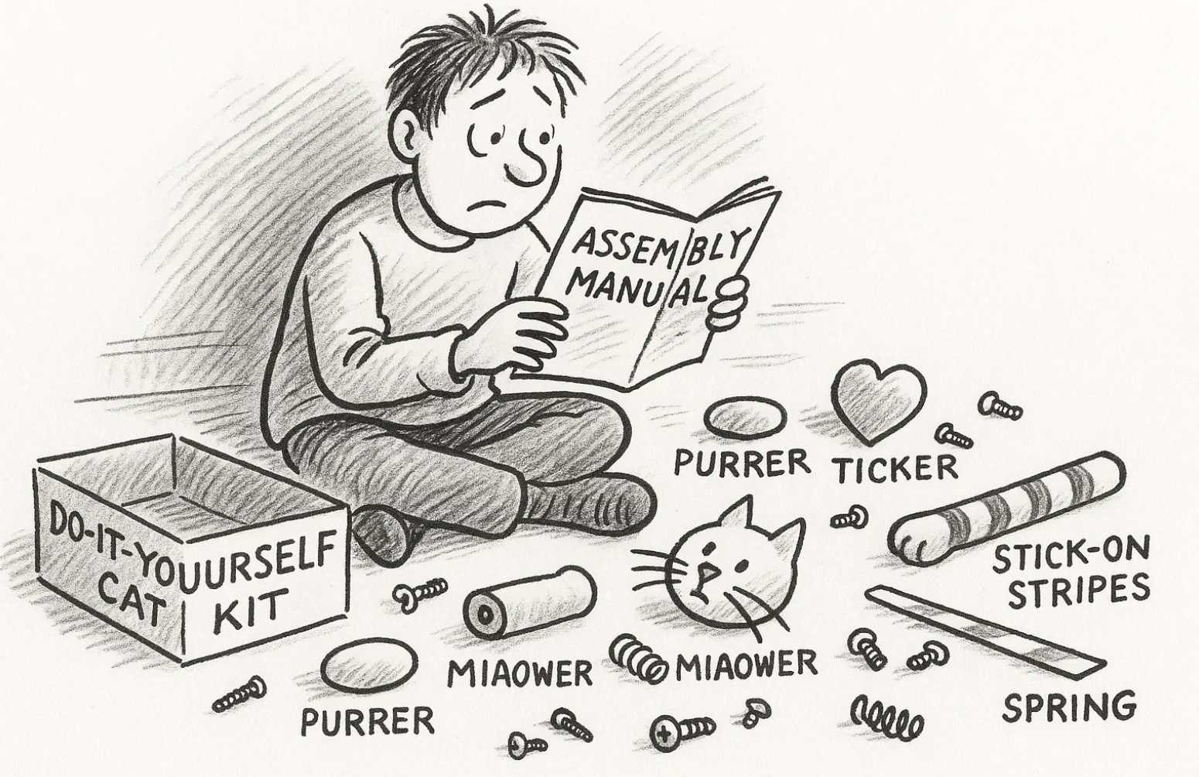

Slide 28
Generalization
Generalization reduces redundancy in problem solving.
Used in many disciplines beyond software (e.g., science, mathematics, engineering).
Embodied in the D.R.Y. principle – Don’t Repeat Yourself.
Methods allow one behavior to be applied to different input data.
Sorting..
Prevents writing identical code in multiple places.
Achieved by classes and inheritance.
Shared characteristics between classes are factored into a new, higher-level class.

Slide 29
Generalization’s benefits
Saves Time
Common code written once in superclass.
Prevents Errors
Fix/update once → affects all subclasses automatically.
Flexibility & Maintainability
Easy to add new subclasses without rewriting common code.
Reusability
Common blocks of code serve many different classes.

Slide 30
Design Structure in UML Class Diagrams and in Java
Design Process -Two Levels of Design
Conceptual Design
Uses CRC cards (Class–Responsibility–Collaborator).
Helps in prototyping, simulation, and client communication.
Avoids distraction of coding.
Technical Design
Uses UML class diagrams (class diagrams).
Provides more detail than CRC cards.
Easier for developers to convert into code.
Connection Between Principles and Diagrams
Abstraction, Encapsulation, Decomposition, and Generalization can all be expressed with UML diagrams and Java.

Slide 31
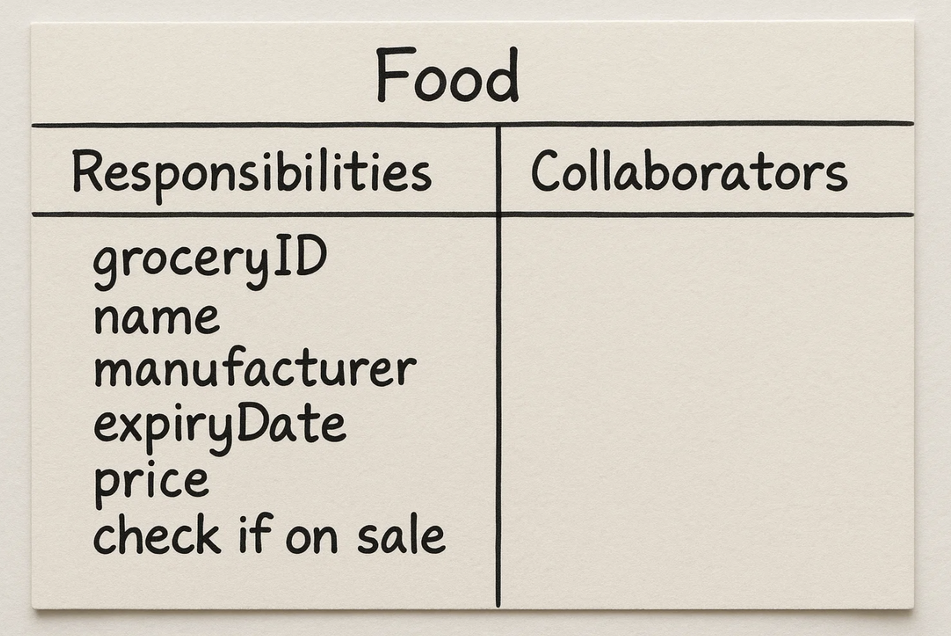
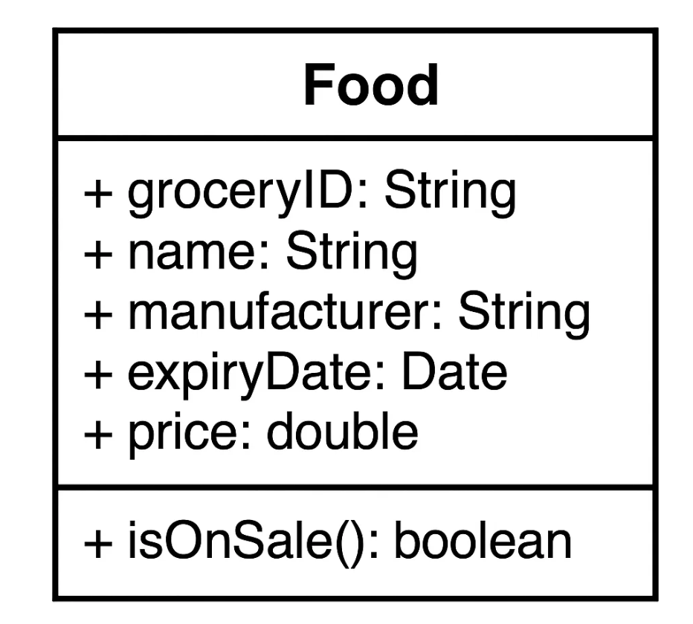
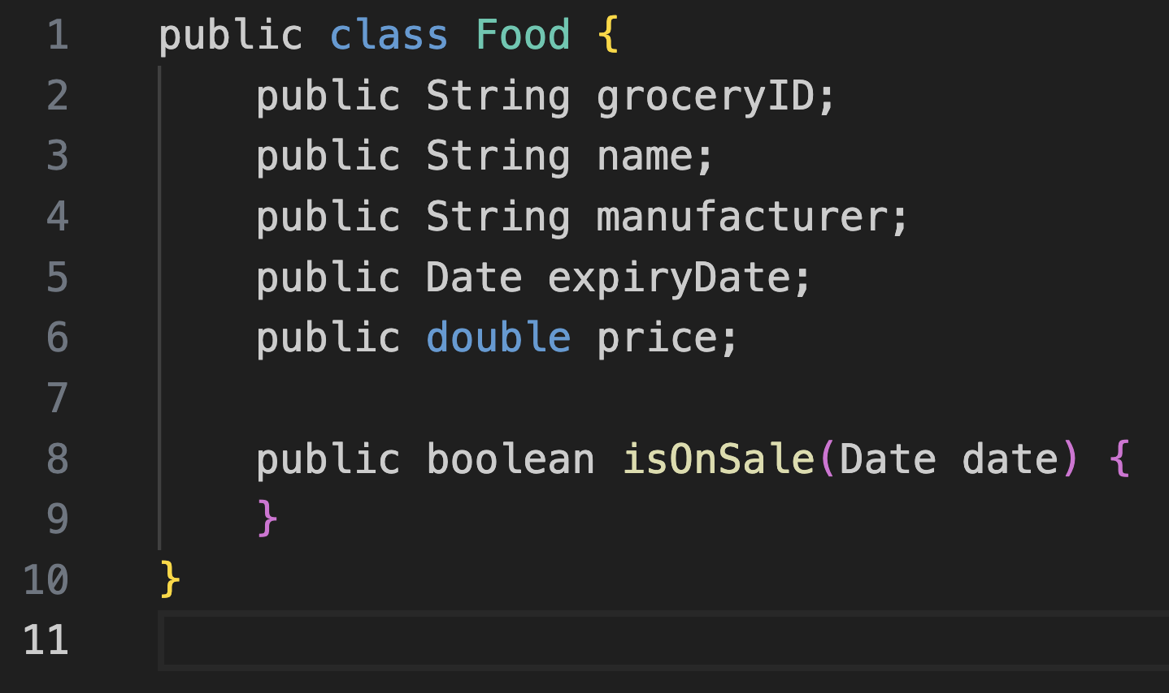


Abstraction
Concept
Simplifies a concept to its essentials in context.
UML diagrams eventually translate into code.
CRC Cards
Capture system components.
Refine into functions, classes, or collections.
Class Name
Responsibilities
Collaborators

Slide 32
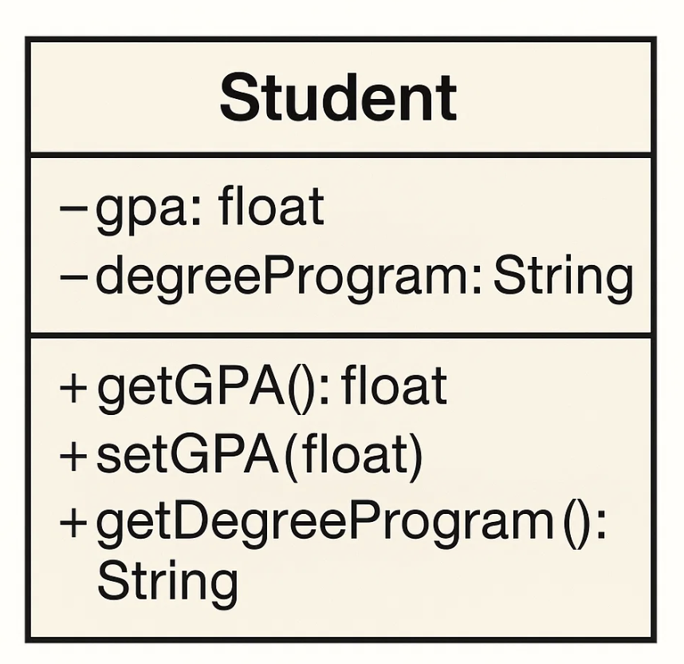
Encapsulation
Definition
Bundles data + functions into a self-contained object.
Controls access to data and methods.
In UML
Attributes = data (class variables).
Operations = functions (methods).
Symbols used:
- = private
+ = public
Class Name
Collaborators

Slide 33
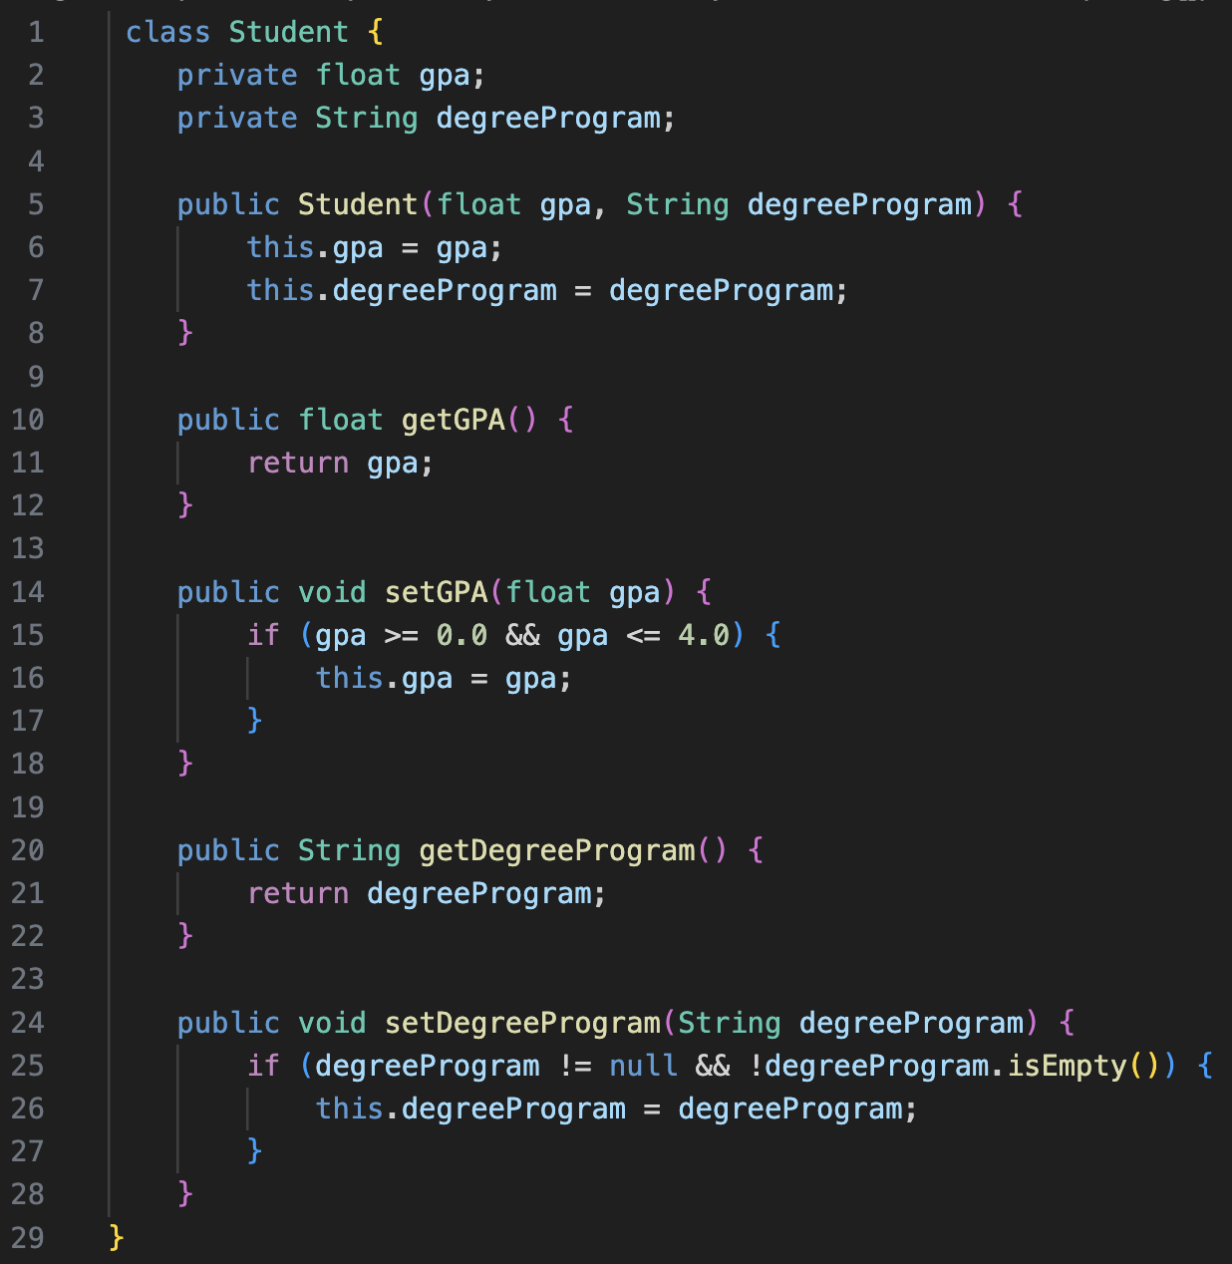
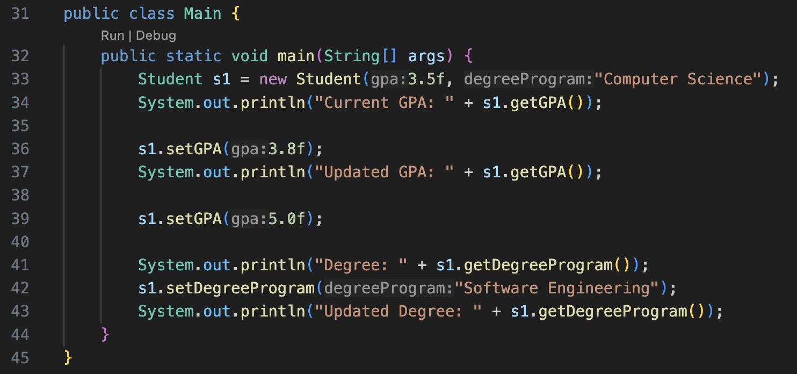

Slide 34
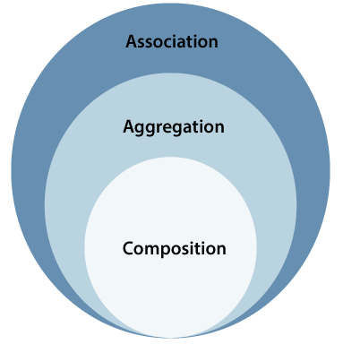
Decomposition
Divides a whole into smaller parts.
Combines separate parts to form a whole.
Three Relationship Types
Association → loose relationship.
Aggregation → weak has-a relationship.
Composition → strong has-a relationship.

Slide 35
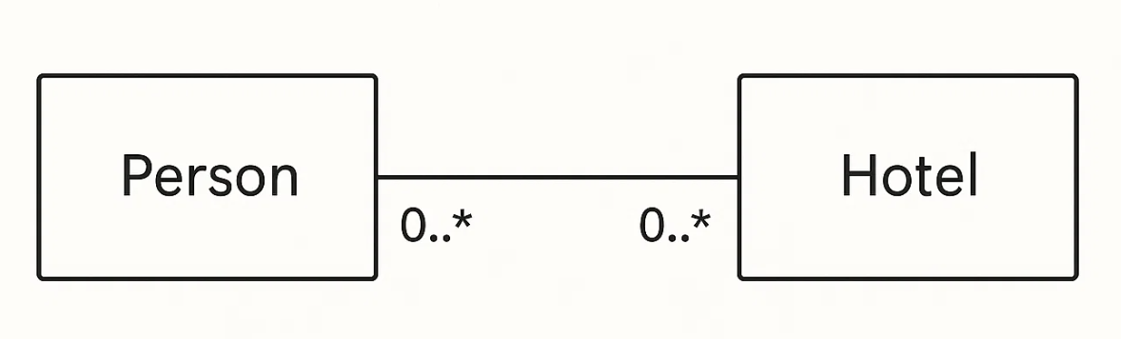
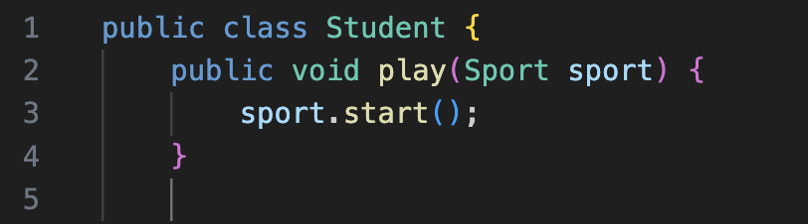
Association
Objects interact temporarily.
They do not depend on each other.
If one is destroyed, the other continues.
Unidirectional or Bidirectional
Person ↔ Hotel (a person stays at hotels, but doesn’t own them).
UML Representation
Straight line with multiplicity (0..*).
Both sides independent.

Slide 36
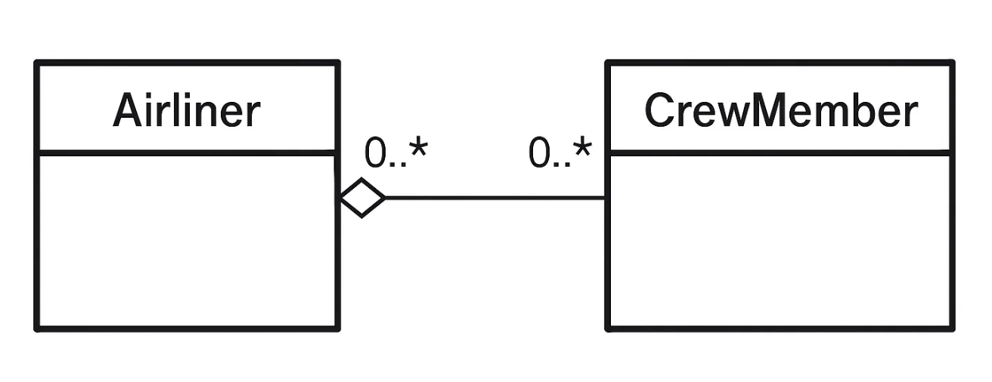
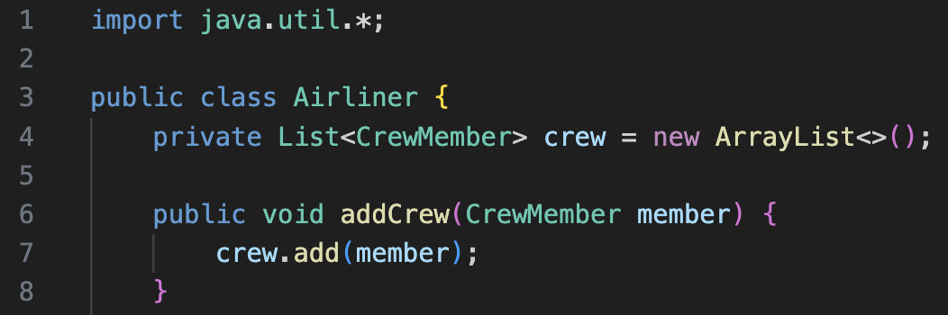
Aggregation
Whole has parts, but both can exist independently.
Parts can belong to multiple wholes.
Airliner ↔ CrewMember (crew can exist without the airliner).
UML Representation
Straight line with empty diamond on the “whole” side.
Multiplicity (0..*) shows many relationships possible.
Airliner has crew, but crew exists independently.
Class A
Class B

Slide 37
Thank You☺

